Slide 1
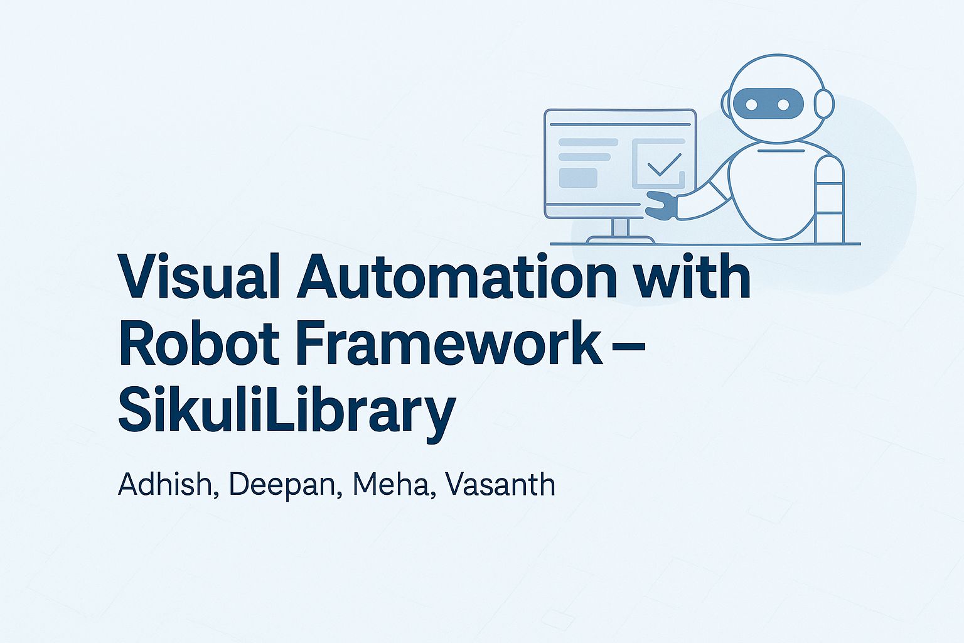
RESULT REALM

Slide 2
INTRODUCTION
This presentation introduces the integration of SikuliLibrary with Robot Framework, highlighting how this combination enables powerful visual test automation.
We will cover: an introduction to Sikuli and Robot Framework, essential keywords and features of SikuliLibrary, how it integrates with other tools, followed by a live demonstration, discussion of challenges.

Slide 3
ROBOT FRAMEWORK
Robot Framework is an open-source automation framework widely used for both testing and robotic process automation (RPA).
Its keyword-driven syntax makes it easy to read and write tests.
It supports numerous libraries, including Selenium and SikuliLibrary, making it highly extensible and powerful for end-to-end automation.

Slide 4
SIKULI LIBRARY
Sikuli Library is a Robot Framework library used to automate graphical user interface (GUI) interactions by utilizing image recognition
It's especially useful when dealing with applications or websites that don't have easily accessible elements like buttons or text fields.
Sikuli can visually identify parts of the screen and interact with them, which makes it great for automating tasks that require image-based recognition or interaction.
KEY FEATURES
Image-based Automation:
Sikuli can capture images of elements (buttons, icons, text) and use them for automation. It works with screenshots of those elements instead of relying on HTML tags or IDs.
Supports Image Matching:
You can use screenshots or image files to match and interact with UI elements, even in cases where traditional locators (e.g., XPath, CSS selectors) are unavailable

Slide 5
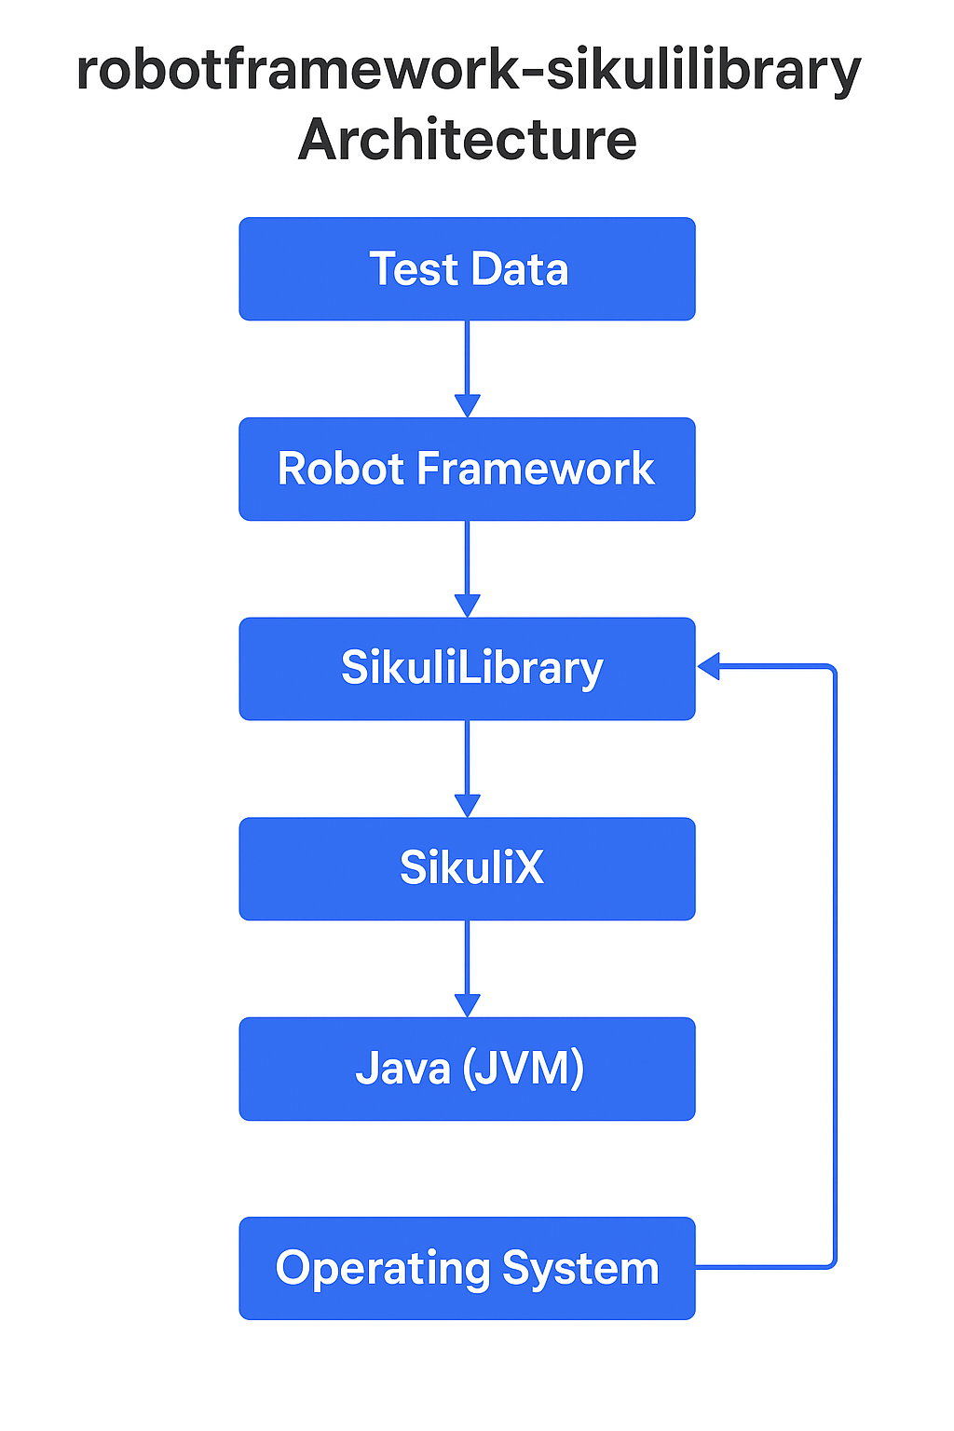
ARCHITECTURE

Slide 6
INSTALLATION & REQUIREMENTS
Before using SikuliLibrary, ensure your system has
Java JDK (version 1.8.0 is stable),
Python 3.12,
Robot Framework, and the
robotframework-sikulilibrary package installed.
The library connects the Robot Framework to Sikuli, which handles the image recognition tasks.

Slide 7
ADVANTAGES
Image-Based Automation
Sikuli works by recognizing screenshots of UI elements. So if you can see it on screen, Sikuli can click or type on it — even if it's not a regular button or field.
Cross-Platform
You can use Sikuli on Windows, macOS, and Linux, making it flexible for different environments.
Great for Complex or Custom UIs
If you're dealing with legacy software, games, or apps without standard UI elements, Sikuli still works because it doesn’t rely on internal code — only on what’s visible.

Slide 8
ADVANTAGES
No Need for HTML IDs or Code Access
Unlike Selenium or other tools, you don’t need to inspect or find element IDs. Just take a screenshot of what you want to interact with.
Supports Mouse & Keyboard Actions
You can automate clicks, double clicks, drag-and-drop, typing, hotkeys — all like a real user would do.
Visual Debugging
During test runs, Sikuli highlights what it's trying to find/click, so it's easy to see where it's failing or what it’s interacting with.

Slide 9
DISADVANTAGES
Screen Resolution & Color Sensitive
If the screen resolution changes or the color/size of a UI element changes slightly, Sikuli may not recognize it anymore.
Slower Performance
Image matching takes time, so Sikuli tests usually run slower than code-based tools like Selenium or Playwright.
Tests Can Break Easily
Even small changes in the UI (like font change, icon shape, dark/light mode) might break your automation because Sikuli depends on pixel-perfect images.
No HTML/Web Page Access
Sikuli can’t read HTML or DOM elements. So if you want to check hidden values or handle alerts inside web pages, it won’t work well.

Slide 10
DISADVANTAGES
Manual Work for Image Capturing
You must manually take screenshots for every element you want to automate — this takes time and effort.
Requires Java
Sikuli is built in Java, so you must install and configure Java to get started — which adds setup steps.
Smaller Community & Fewer Resources
Compared to Selenium or Appium, Sikuli has fewer tutorials, tools, and community support. If you face an issue, it might take longer to find help.

Slide 11
Why Use Sikuli with Robot Framework?
SikuliLibrary extends the capabilities of Robot Framework to allow automation of UI elements that are visually rendered.
This is especially useful for automating legacy desktop applications or components outside the browser's DOM.
It brings the benefits of visual recognition to an already robust test automation framework

Slide 12
KEYWORDS
SikuliLibrary offers a set of basic keywords such as
openApplication and closeApplication,
Click(ClickIn,doubleClick,clickRegion),
inputText,
addImagePath,
waitForImage,
captureScreen, and
exists etc,.
These commands allow your scripts to interact with the screen as a human would, by visually locating and manipulating interface components.

Slide 13
COMPONENTS
Screen Class – Represents the display screen.
Region Class – A subsection of the screen.
To improve performance and precision, SikuliLibrary allows defining screen regions. By limiting the search area, these regions help reduce false positives and increase the speed of image matching, especially useful in large or complex interfaces.
Pattern Class – Defines an image to search for.
A pattern in Sikuli consists of an image file combined with an optional similarity score. For instance, using Click image.png 0.8 instructs Sikuli to look for an 80% match. This flexibility is essential when images are slightly altered across runs.
Match Class – Represents a found image on the screen.

Slide 14
IMAGE HANDLING
When you're using SikuliLibrary, the accuracy and reliability of your tests depend a lot on the images you use. Here are some simple things to make sure your images work well,
Use Clear, High-Quality Images
The better your images, the more accurately Sikuli can match them to elements on the screen.
Crop Images Tight
If your image contains unnecessary background or extra space, Sikuli might struggle to find it on the screen.
Avoid Dynamic or Animated Content
If the image contains animations (like loading spinners) or changing content (like dates), Sikuli might not recognize it properly.
Ensure Consistent Screen Resolution
If your screen resolution changes between when you capture the image and when you run the test, the match might fail.

Slide 15
REAL-WORLD USE CASES
SikuliLibrary is ideal for automating software like Notepad or Calculator, where no HTML or DOM is involved.
It also works well for Flash applications and dropdowns or popup windows that aren't easily controlled with standard web automation tools.

Slide 18


